Slide 1

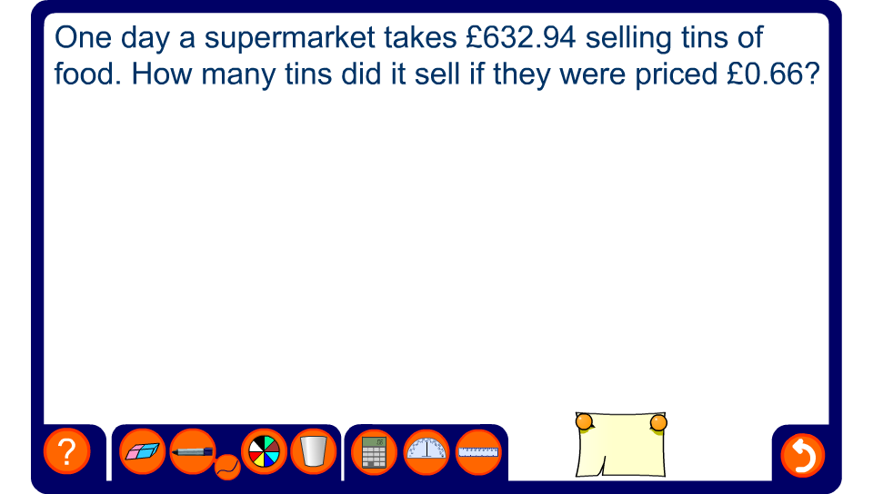


Long division
Notes:
Use the pen tool to complete the calculation on the board.

